Slide 1

Geometry based Encryption Algorithm

Slide 2

Cryptology – Ceaser to AES
Symmetric Encryption - Same Key
Asymmetric Encryption – Public and Private keys
Stream Cipher – One Byte at a time (Ceaser, RC4, FISH)
Block Cipher – 8bits to 512Bytes at a time (AES, RC5, Blowfish)

Slide 3
To keep in mind
Attacks
Key Length
Authentication
Performance

Slide 4
Attacks
Linear Cryptanalysis – Linear Algebra
Differential Cryptanalysis – Non random behaviour of algorithm
Related-Key attack – Relationship between the keys
Weak Keys – Undesired behaviour of algorithm
Known Plain-Text attack – knows the Plain and Cipher text
Cipher Text-only attack – some knowledge about the plain text

Slide 5
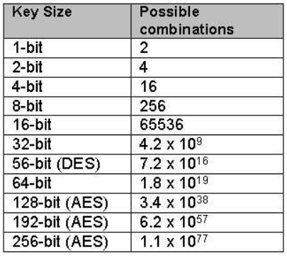
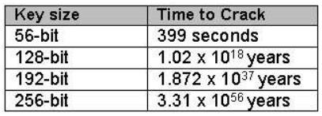
Key Length
Brute Force Attack
Exponential increase in possible combinations as the key size increases
Difference between cracking the 128 algorithm and 256 algorithm is considered minimal

Slide 6
Authentication
Why Authenticate?
Noise and Surety
Ways to Authenticate:
MAC then Encrypt
Encrypt and MAC
Encrypt then MAC

Slide 7
WHAT IS NEW?
Mapping characters/Blocks to points in X-Y plane
Symmetric Algorithm
Multiple Keys
No more pseudo random numbers
Keys length up to 128bits
Can encrypt file of any type (No need to convert images to strings)
A Block Cipher that can be very easily parallelized

Slide 8
How does it work?

Slide 9
Codebook
(15,10)
(15,15)
(11.24,13.75)
(10,10)
(15,10)
width

Slide 10
Other configuration option
Width = 5 units
FPPB (Floating Point Precision Bits) = 8
Total characters = 2 ** 8 = 256
Xmax = 500
Ymax = 500

Slide 11
ASSUMPTION
Both the sender and receiver have same Codebook.
Both the sender and receiver know all the configuration options.

Slide 12
Encryption
Assume we want to encrypt a block of size 1byte (8 bits)
Let the byte value be 65
We choose any 2 random numbers less than xmax and ymax respectively.
Let us call them intX and intY with values 11 and 13 respectively.
We choose another 2 random numbers keeping in mind our precision values.
We will call them floatX and floatY with values 024 and 079 respectively.
Find the key from the Codebook using intX and intY.

Slide 13
Encryption
Key = Codebook[10][10] = (1001 1100 0101 1010)b = 40026
Concatenate floatX and floatY to create a 16bit number say floatXY
floatXY = 0001 1000 0100 1011 = 6219
floatXYXor = floatXY ^ key = 33809
Find Beta = floatXYXor % (2**8) = 17
Find diff = Byte – Beta = 65-17 = 48

Slide 14
Encryption
newFloatXY = floatXYXor + diff = 33809+48 = 33857
Separate [newFloatX,newFloatY] = [newfloatXY] = (0001 1000 0001 1011)b
newFloatX = 00011000 = 24, newFloatY = 0001 1000 0001 1011 = 27
Point encrypted is 11.024 , 13.027

Slide 15
Decryption
Point (x,y) = (11.24,13.27)
intX = 12 , intY = 13, floatX = 024, floatY = 027
Key = Codebook[10][10] = 1001 1100 0101 1010 = 40026
floatXY = 0001 1000 0001 1011 = 6171
floatXYXor = floatXY ^ key = 33857
Byte = floatXYXor % totalCharacters = 33857 % 256 = 65
Byte = 65

Slide 16
Block Sizes
We just saw the implementation of Block size of 1byte/8bits
The same has been extended to Block size of 8bytes/64bits
Bigger the block size higher the performance
The key length = 2 * Block size so a key of 128bits has been successfully tested.
As instead of working on characters we are working on bytes we can encrypt/decrypt any type of file.
Successfully checked on txt,docx,png,mp3,mkv and bin file formats.

Slide 17
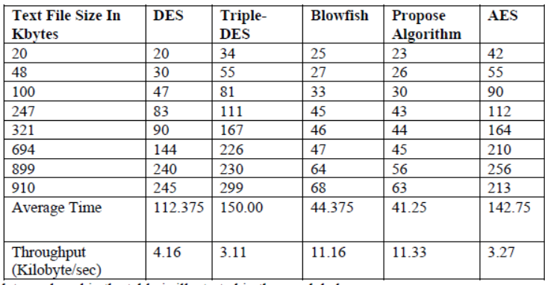
Performance
We are planning to run the other algorithms code on our system to get an actual difference.
Current Performance :
(64Bit block size)
→ 256 MB in 55 seconds
4.65MB/s
→ 4880.65 KB/s
(i5-intel, Dual Core, 2.2GHz, 8GB)
(AMD Athlon TF-20, 1.6GHz, 3GB)

Slide 18
Future Work
Increase Key/Block Size
Code Optimisation
Padding
Performance Comparison
Avalanche Effect
Authentication
Paper

